Slide 1
Battle of the Neighborhoods
Applied Data science capstone – Diego Talavera

Slide 2
Obtaining venues clusters
If you need to shop items in different stores, you may want to find a place where all the stores are close to each others
While in some cities malls are commonly found, some others might not have them, therefore the location of individual stores must be known
A simple recommendation tool was developed to find the best option for the shopping on a specific set of different venue categories

Slide 3
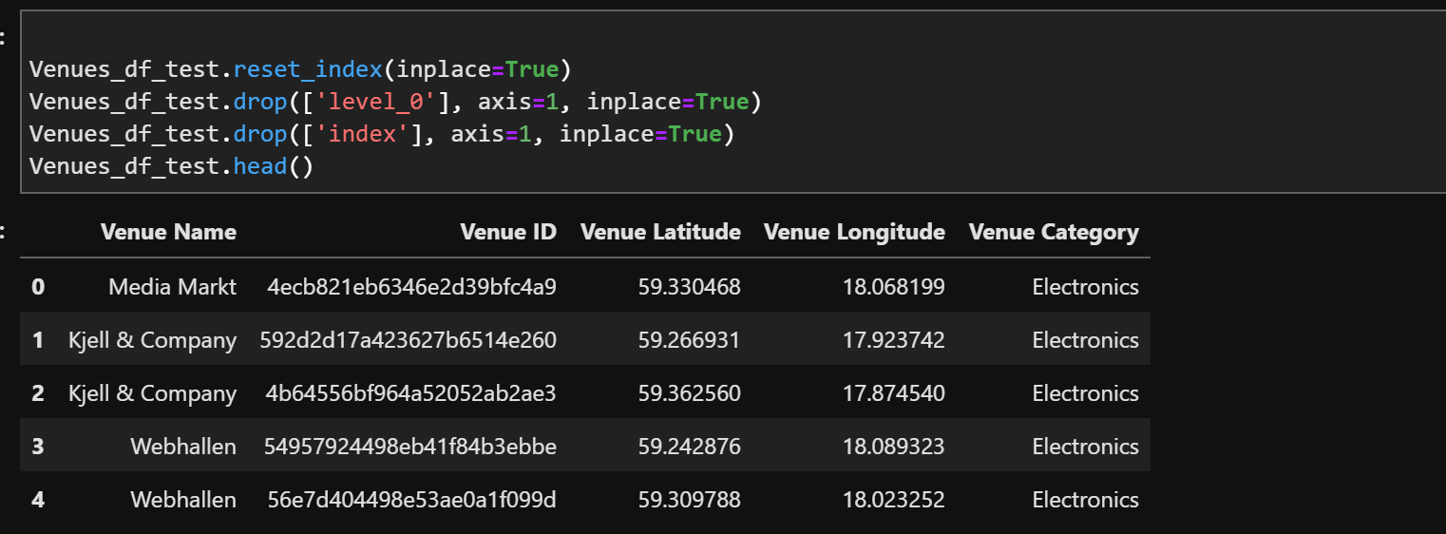
Data acquisition and pre-processing
Data was obtained with the foursquare API through a Jupyter notebook using python.
After cleaning the raw data from the API a dataframe was constructed containing a few attributes as can be seen in the image in this slide

Slide 4

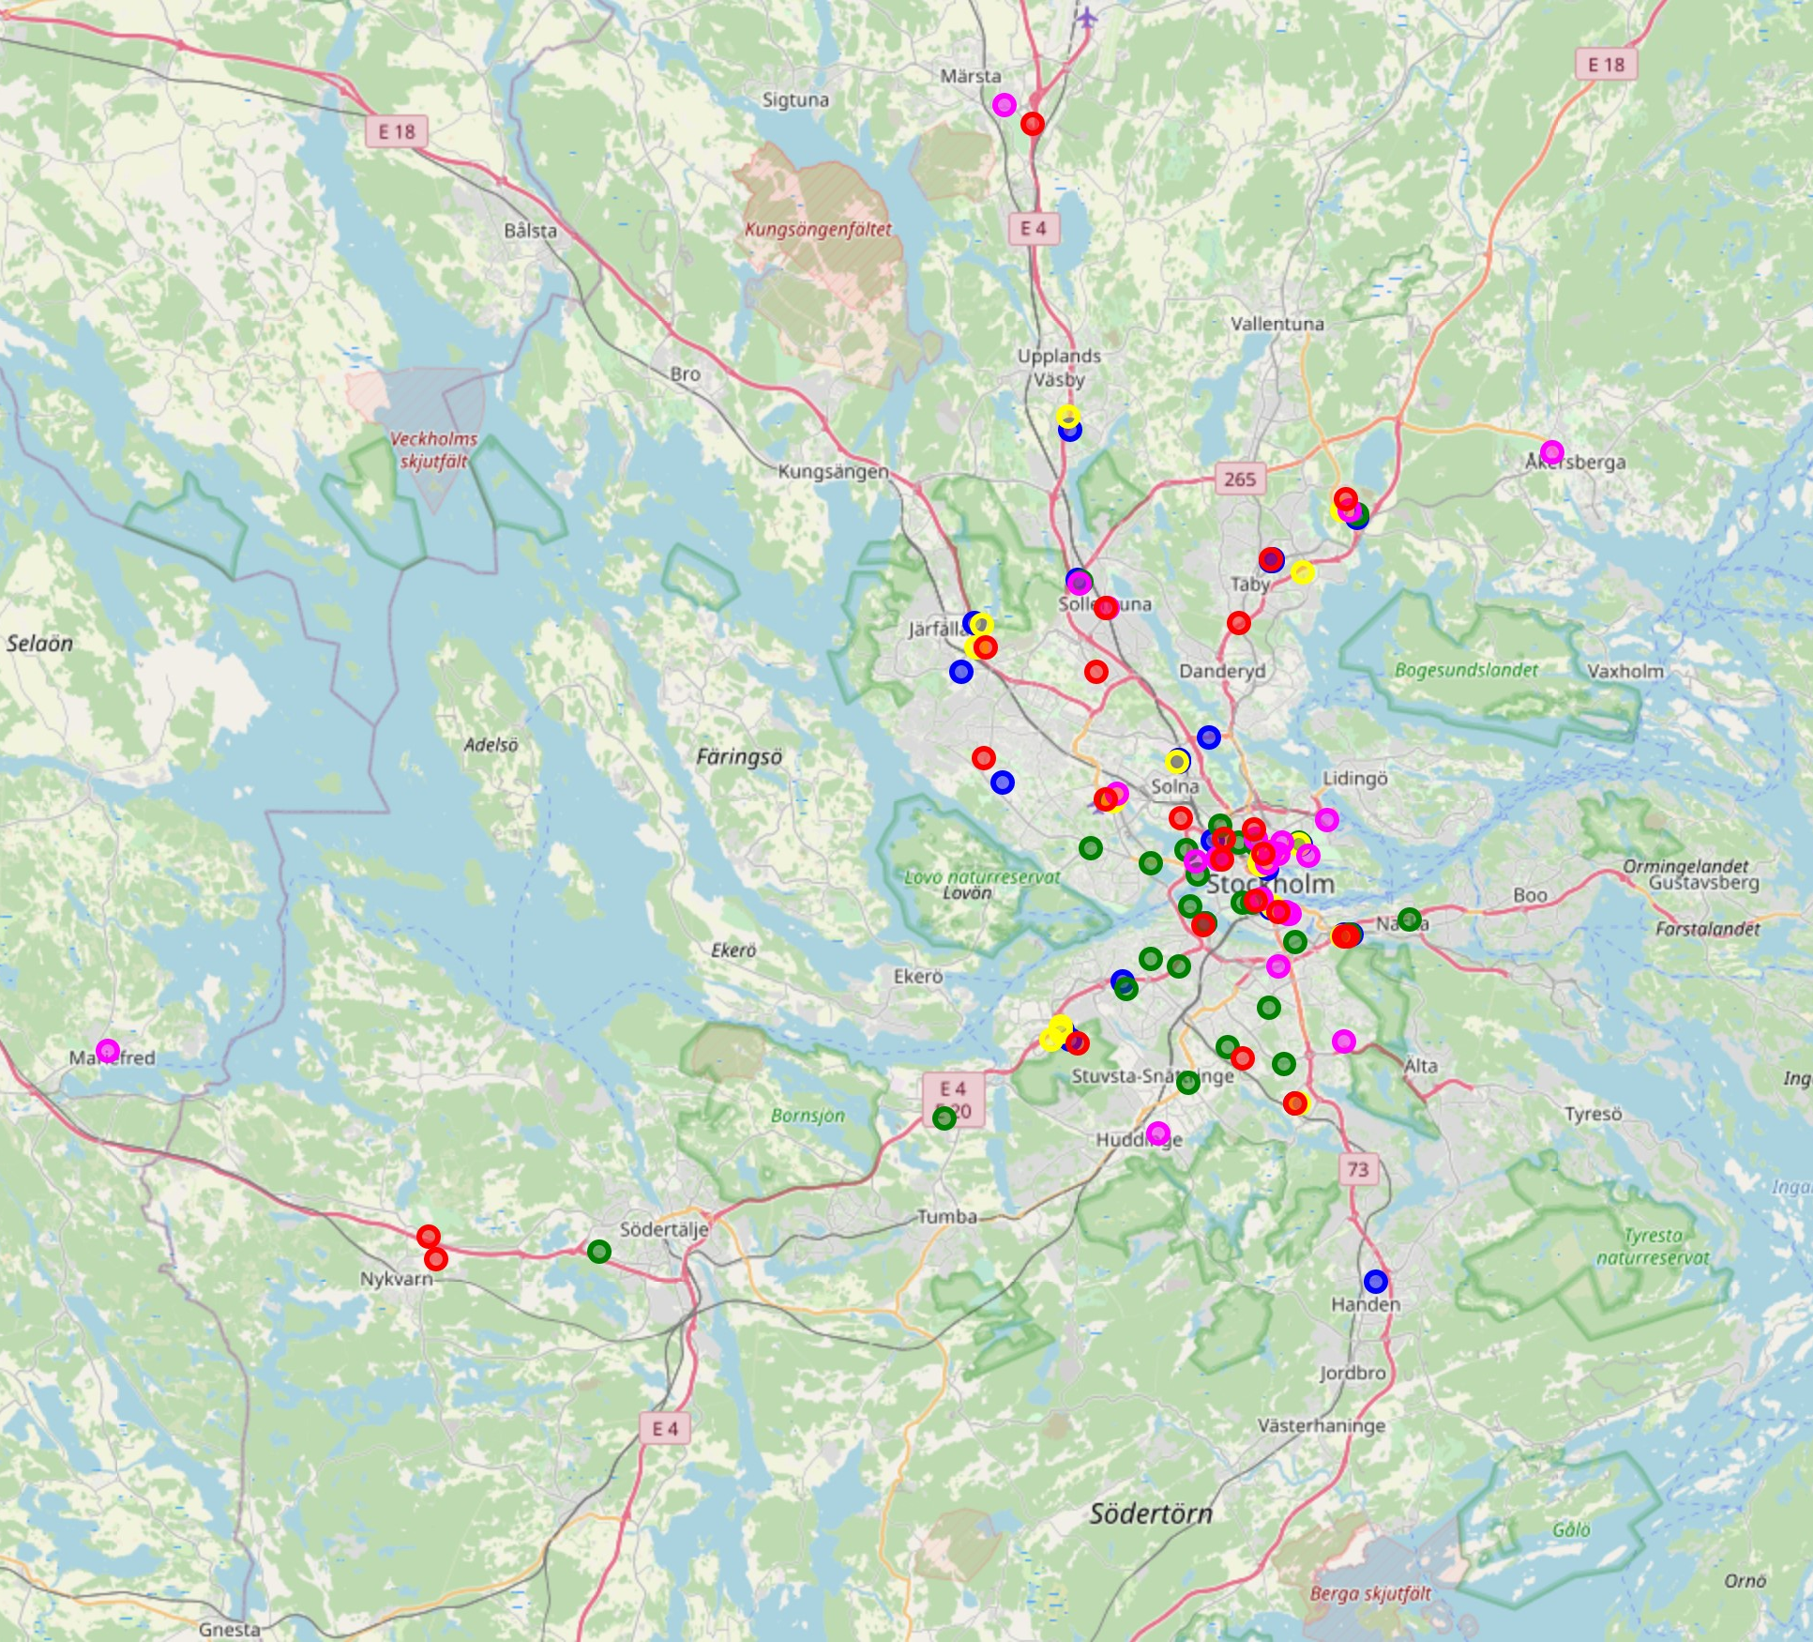
Venue visualization
Venues where plotted using the library Folium in order to visualize them and proceed with any further cleaning and processing that was deemed necessary.
Afterwards, venues farther away than 16.5km were dropped as they clearly don’t form dense enough areas

Slide 5
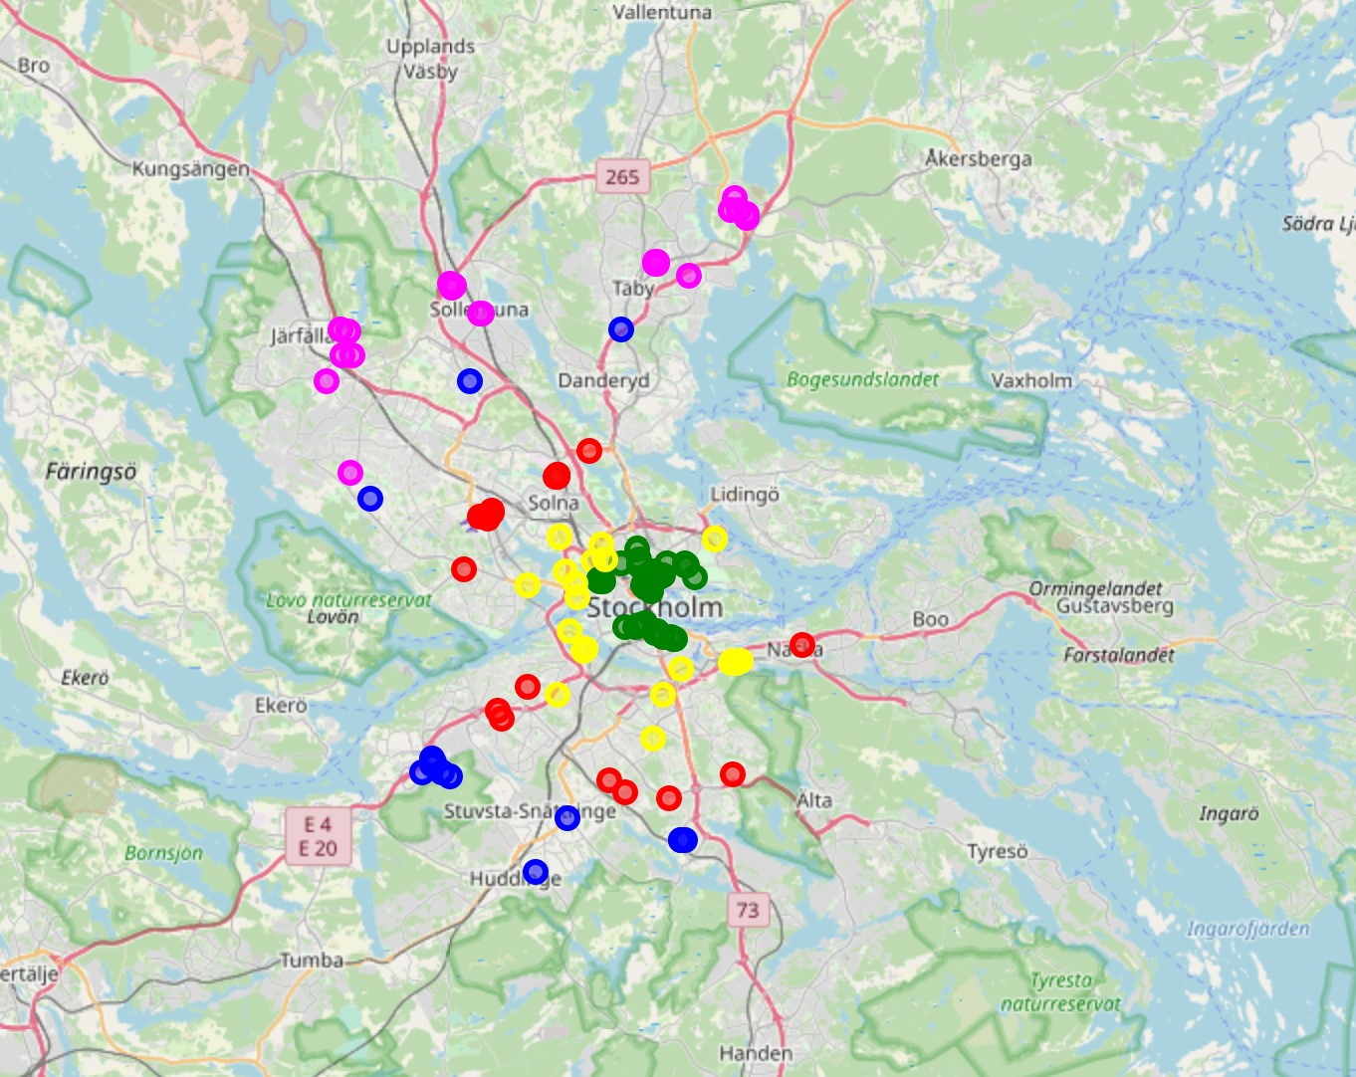
K-Means algorithm
K-Mans was used to generate some first clusters or zones that helped visualize different regions around our starting point.
As it can be seen, there are several places that could potentially have the venues we needed.

Slide 6
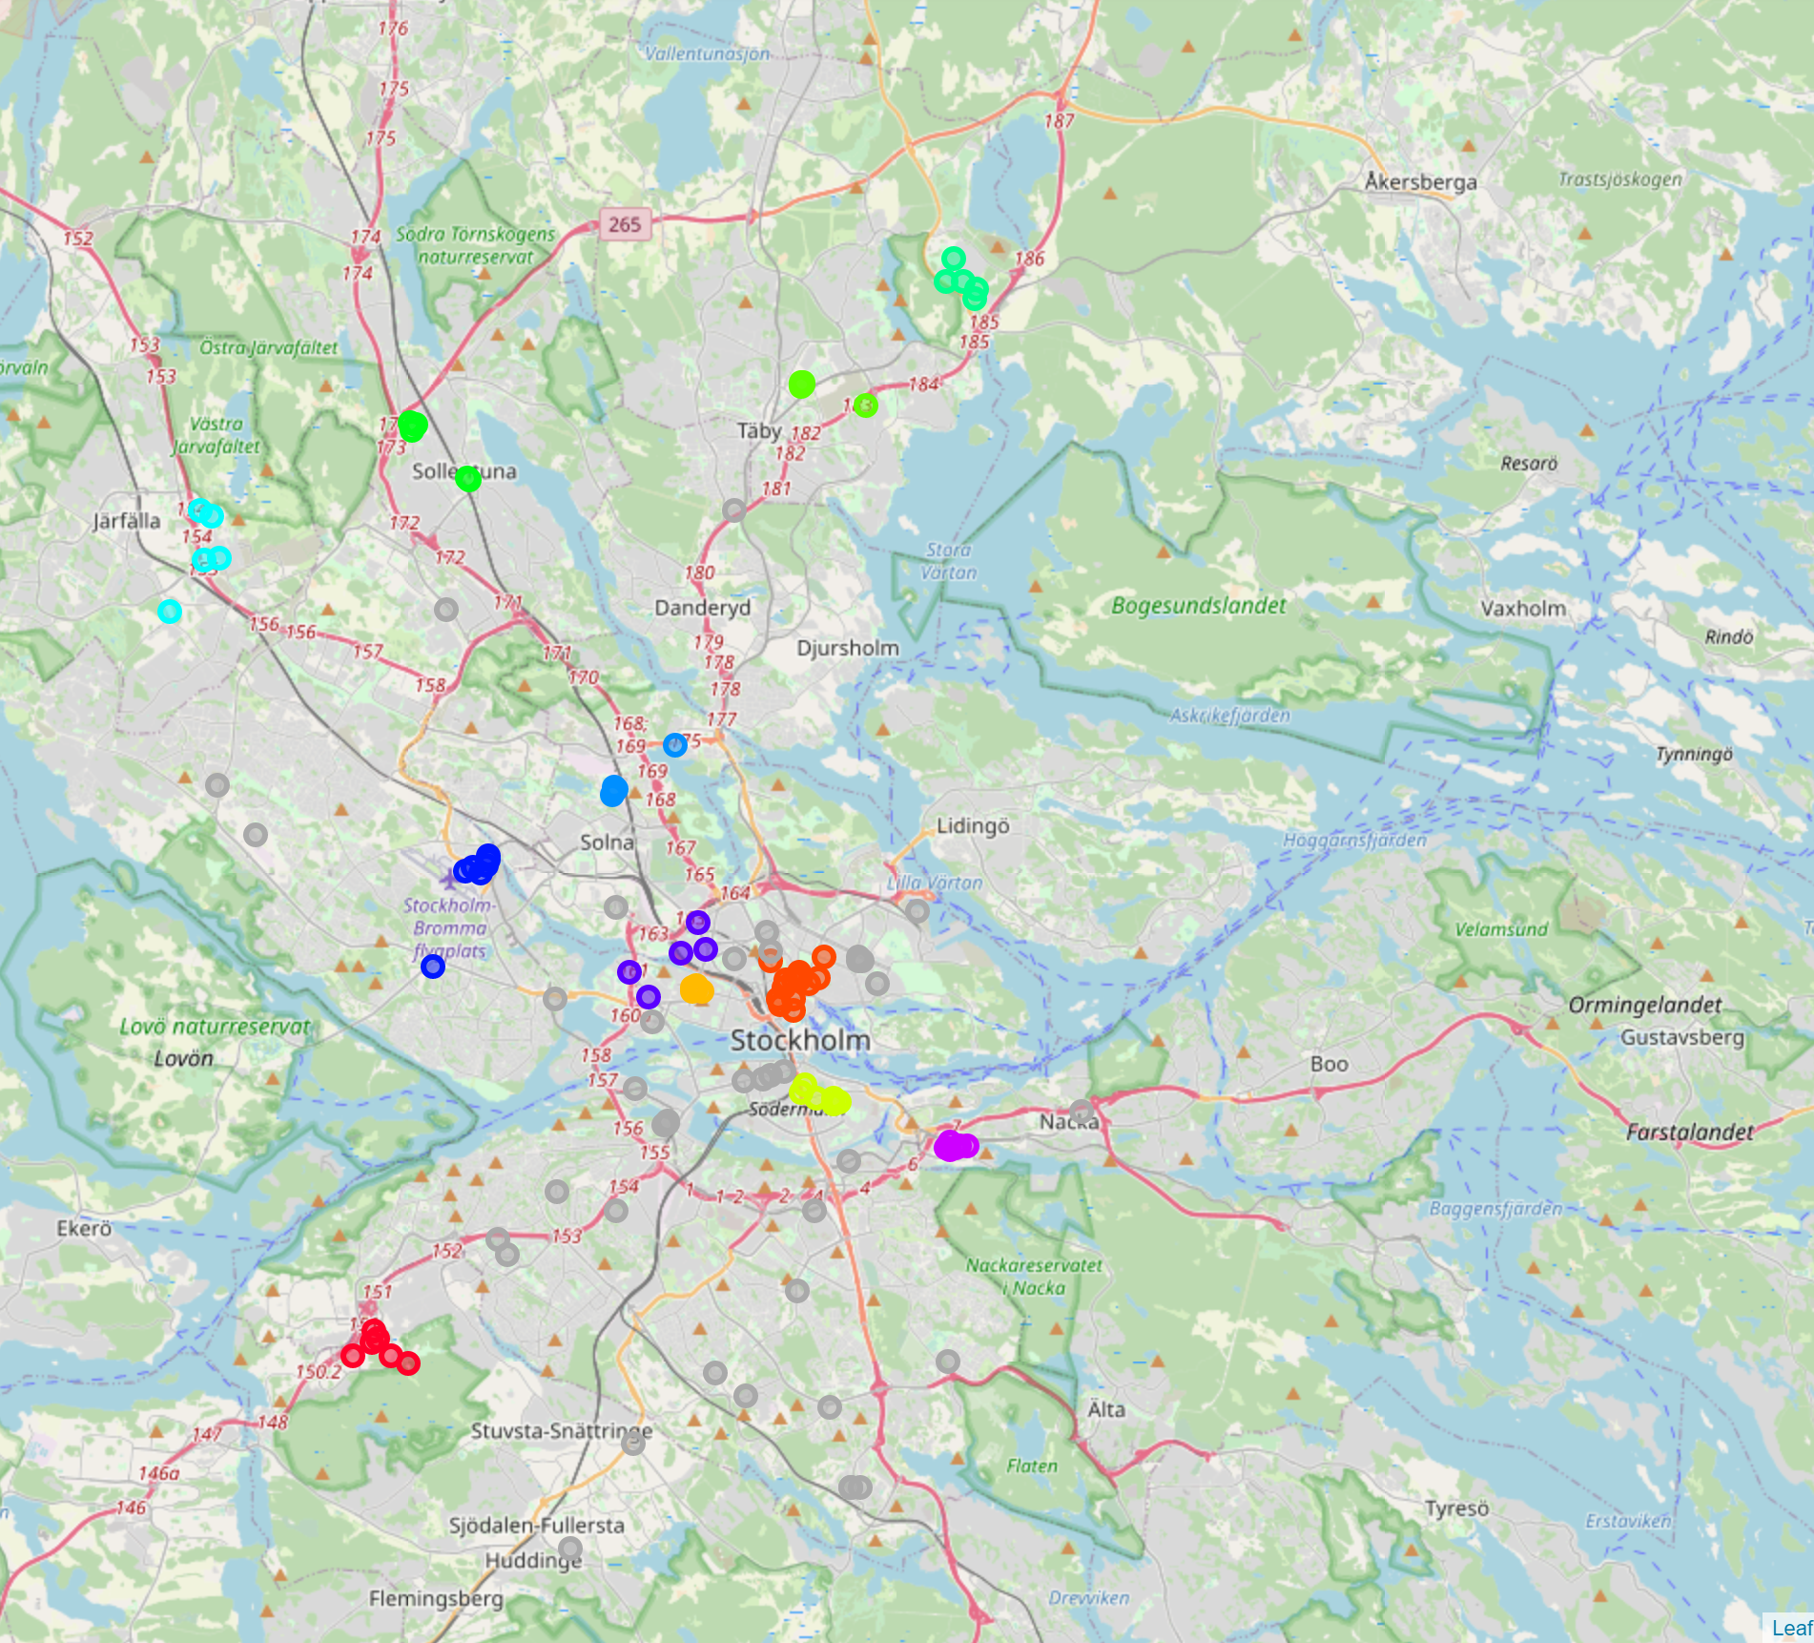
DBSCAN algorithm
This algorithm was used to form clusters in the densest regions of the map, in order to find the best venue cluster. This resulted in a clustering as follows:

Slide 7
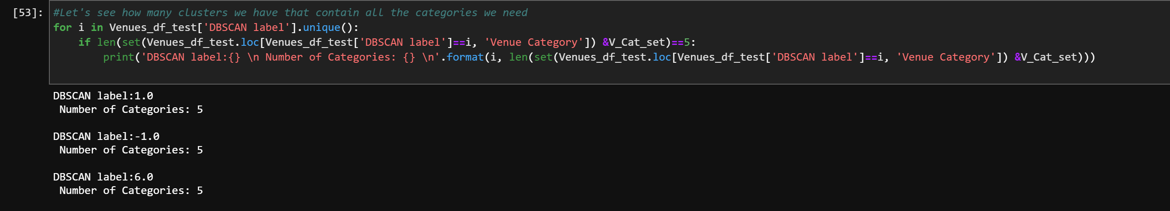
Useful Clusters Selection
Further analysis showed that only 2 clusters had the venue categories that we needed. The code used can be seen in the following image
Note that even though we have 3 “clusters” that comply with the requirements, the one with label “-1” is the one containing the noise of the DBSCAN (Grey dots) therefore it was not further considered.

Slide 8
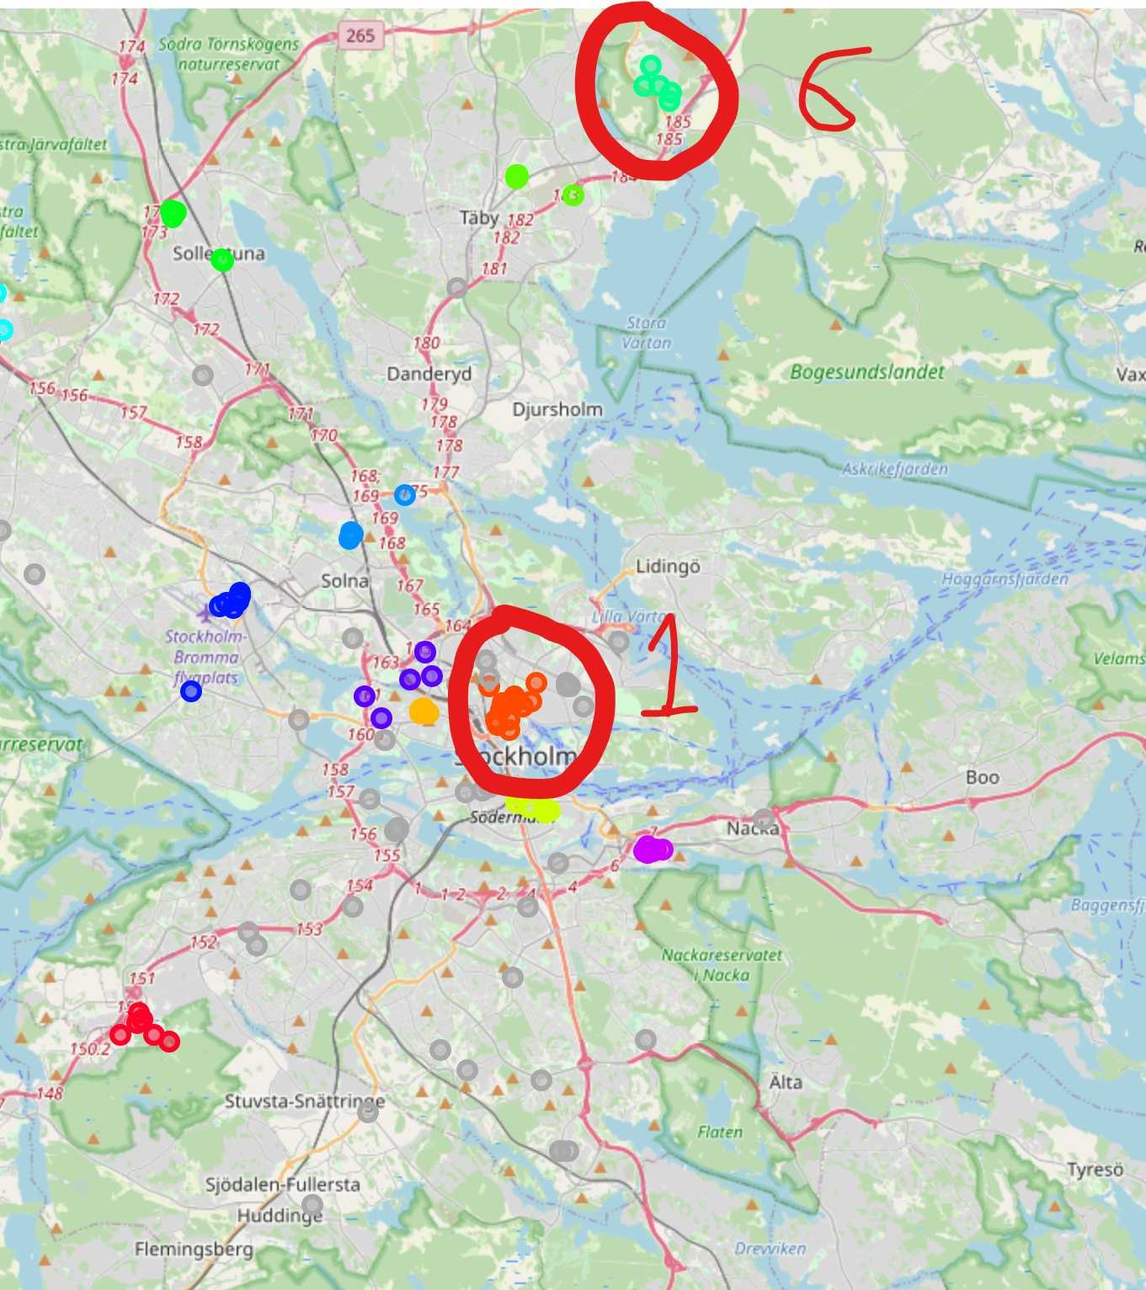
These two clusters where further analysed to determine the best option. Note that the starting point is very close to cluster number 1.

Slide 9
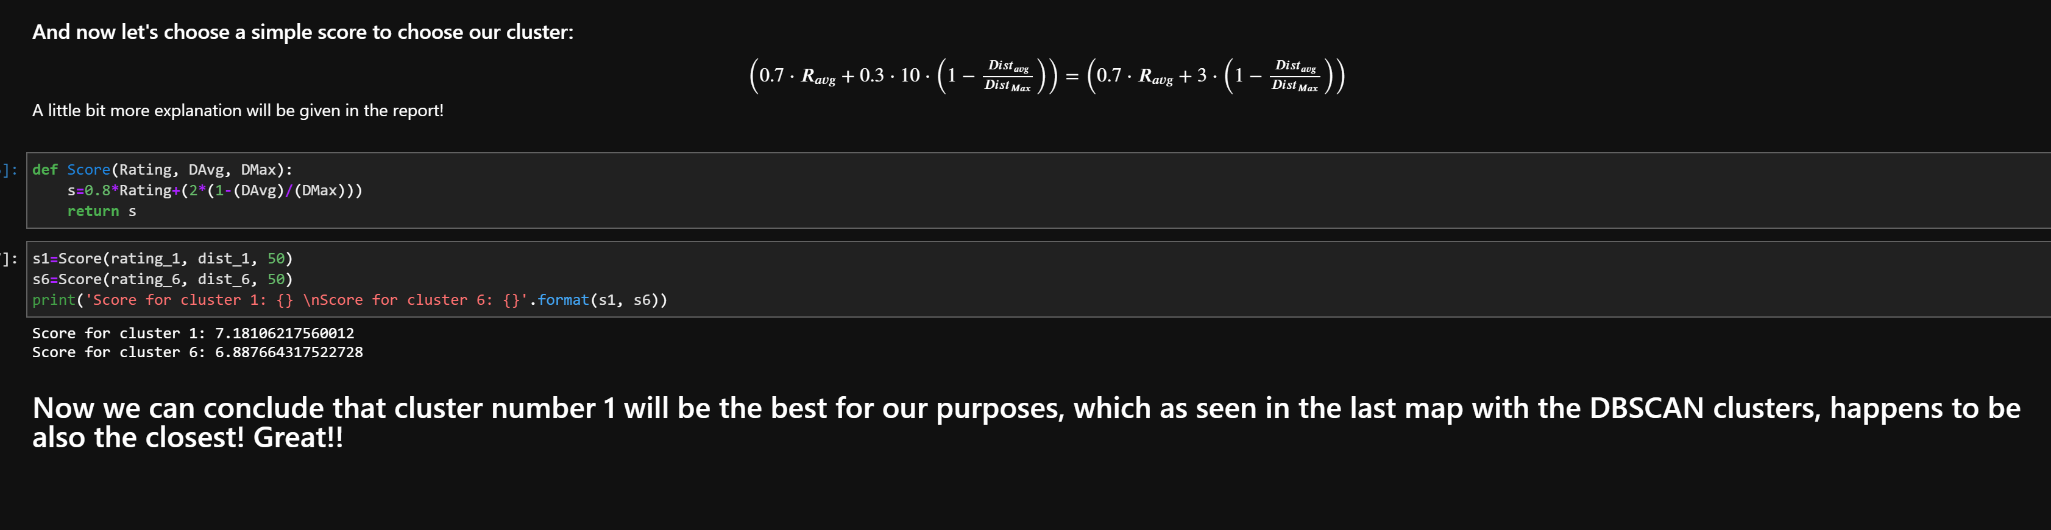
Final Cluster Selection
A simple scoring system was chosen as follows and the best cluster was selected:

Slide 10
Conclusions and Recommendations
The tool developed here can proved insight into better shopping options in order to optimize time used.
The development of this project very helpful to increase the familiarity with several data analysis tools and methods.
A different clustering algorithm can be used instead of DBSCAN, however it would increase the complexity of the code. This is described further in the report provided.
Machine learning algorithms can be extremely useful in a wide variety of situations, even if such seem as mundane. The example studied in this project is a clear example of this and there are several ways to increase its complexity and applications. Some options include:
Consider traffic data
With some web scraping, price of the selected items can be considered in the scoring parameter.
Consider streets/highway distance instead of straight-line distances
Thanks for reading!

